Slide 1
Online voting system

Slide 2
index
Introduction
Objective of Project
Project justification
Hardware Requirements
Software Requirements
Old Methods Of Voting
Proposed system
Security issues of online voting
Problems with Existing Voting Registration System
Advantages and disadvantages
Conclusion

Slide 3
INTRODUCTION TO ONLINE VOTING SYSTEM
“ONLINE VOTING SYSTEM” is an online voting technique. In this system people who have citizenship of INDIA and whose age is above 18 years and any sex can cast the vote online without going to any physical polling station.
There is a database which is maintained in which all the names of voters with complete information are stored.
In “ONLINE VOTING SYSTEM” a voter can use his\her voting right online without any difficulty. He\She has to be registered first for him/her to vote. Registration is mainly done by the system administrator for security reasons.

Slide 4
OBJECTIVES OF THE PROJECT
The specific objectives of the project include:
Reviewing the existing/current voting process or approach in INDIA;
Coming up with an automated voting system in INDIA;
Implementing an automated/online voting system;
Validating the system to ensure that only legible voters are allowed to vote.

Slide 5
HARDWARE REQUIREMENTS:
Microsoft Windows XP Professional SP3/Vista SP1/Windows 7 Professional:
Processor: 800MHz Intel Pentium III or equivalent
Memory: 512 MB
Disk space: 750 MB of free disk space

Slide 6
Software requirements
MYSQL DBMS.
Testing- is done via WAMPSERVER.
Adobe Dreamweaver CS3.
Web browsers.

Slide 7
Old Methods Of Voting
Paper-based voting
Lever voting machine
Direct recording electronic voting machine
Punch card
Optical voting machine

Slide 8
Proposed system
With the existing system we are planning to implement the online voting through mobiles and internet. By using our application user can vote from any corner of the world and a authentication is performed to verify the user who is going to vote. If the user is using mobile user has to send SMS to our site, the site will send a unique key. This key will be sent to the user as password. Once the authentication is done voting chart will be shown. Then we can show the list of nominees and user can vote.

Slide 9
Advantages
By using our project we can reduce the cost which is used for elections.
This will become a corruption free voting system.
No proxy voting.
Secured voting with the One Time Password (OTP) to voters mobile.
Fully secured with FINGER PRINT SCANNER & RETINA SCANNER (OPTIONAL FOR FUTURE USE).

Slide 10
Disadvantages
To access this user must have internet facility and should have the knowledge of using web sites.

Slide 11
Conclusion
By using this application election can be conducted with good percentage of voting and we can involve the number of citizens in voting with a good percentage which provides good results for elections. No one can miss the elections in our country.

Slide 12
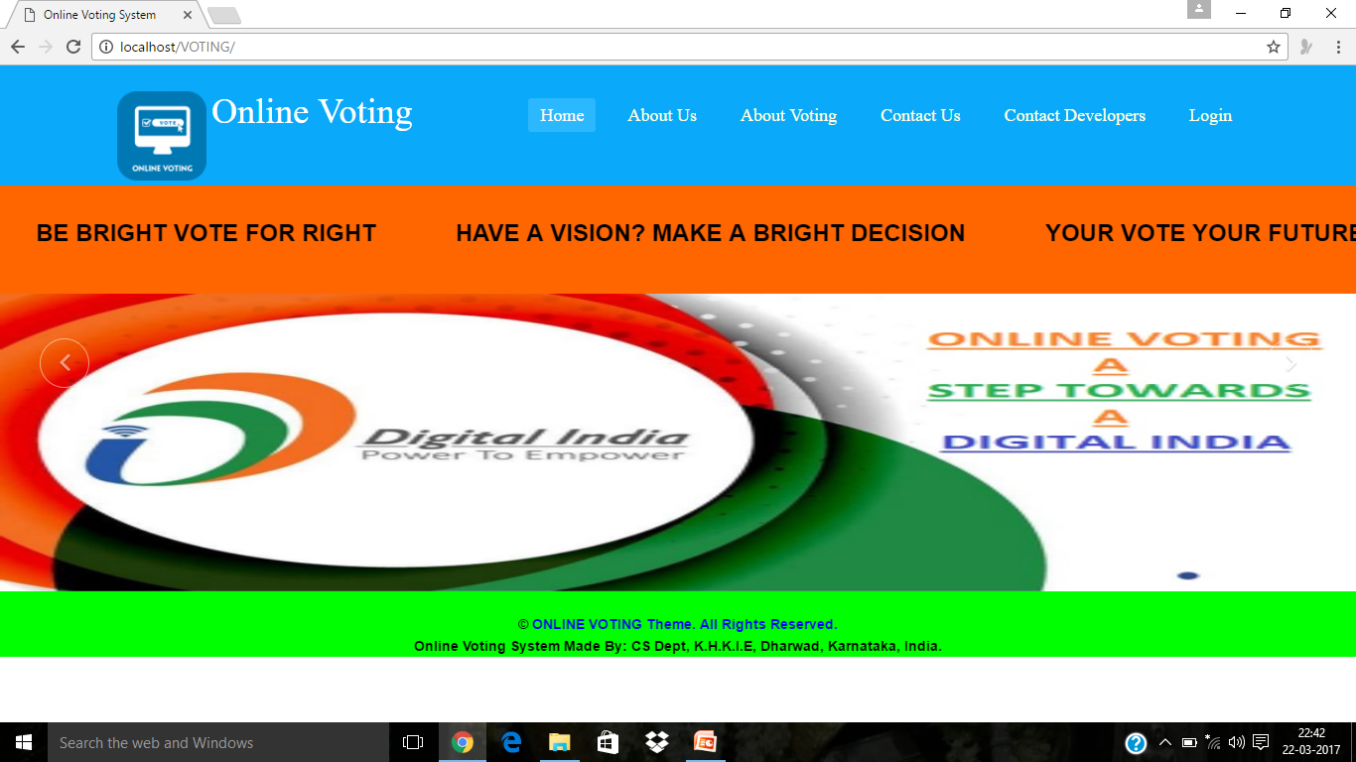
Screen shots of the project main page

Slide 13
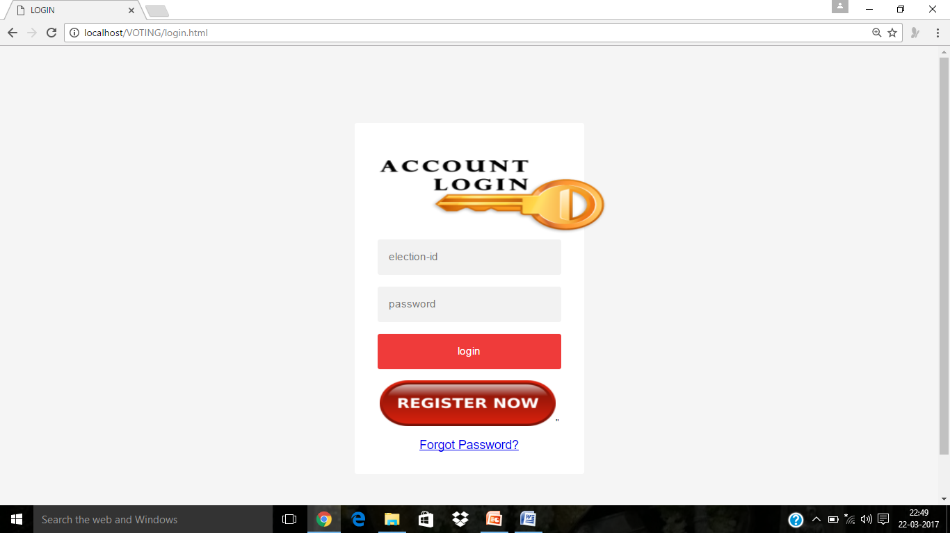
Login page

Slide 14

Logging in as a admin

Slide 15
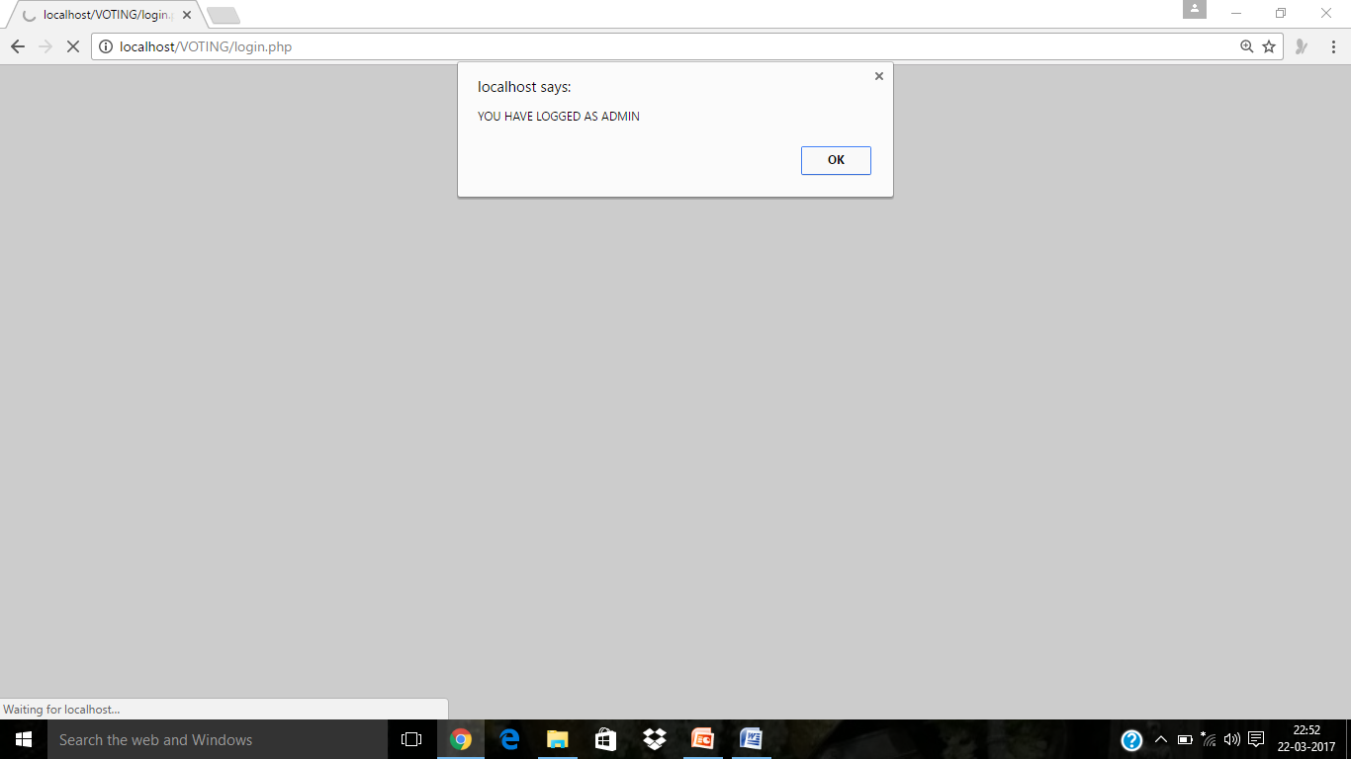
Logged in as a admin
Logged in as a admin

Slide 16
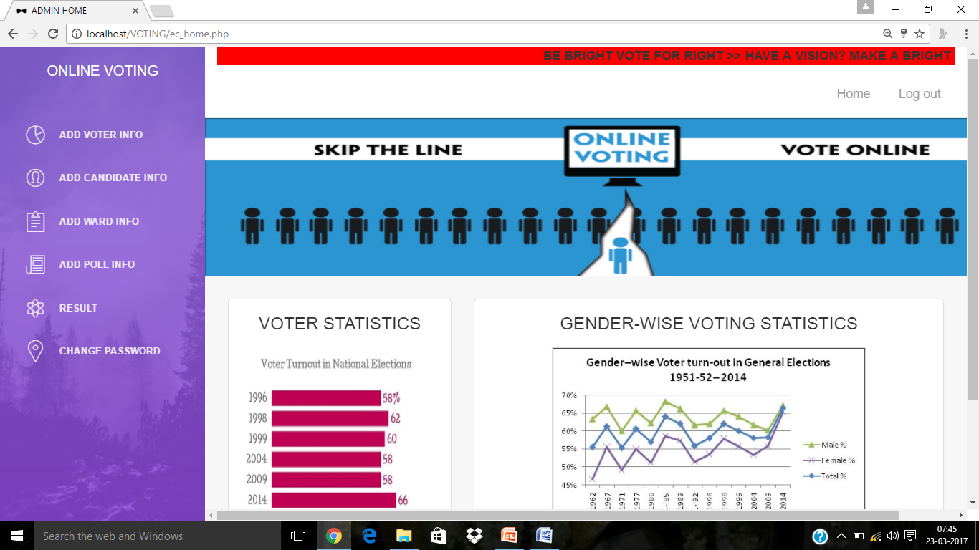
Admin Home page

Slide 17
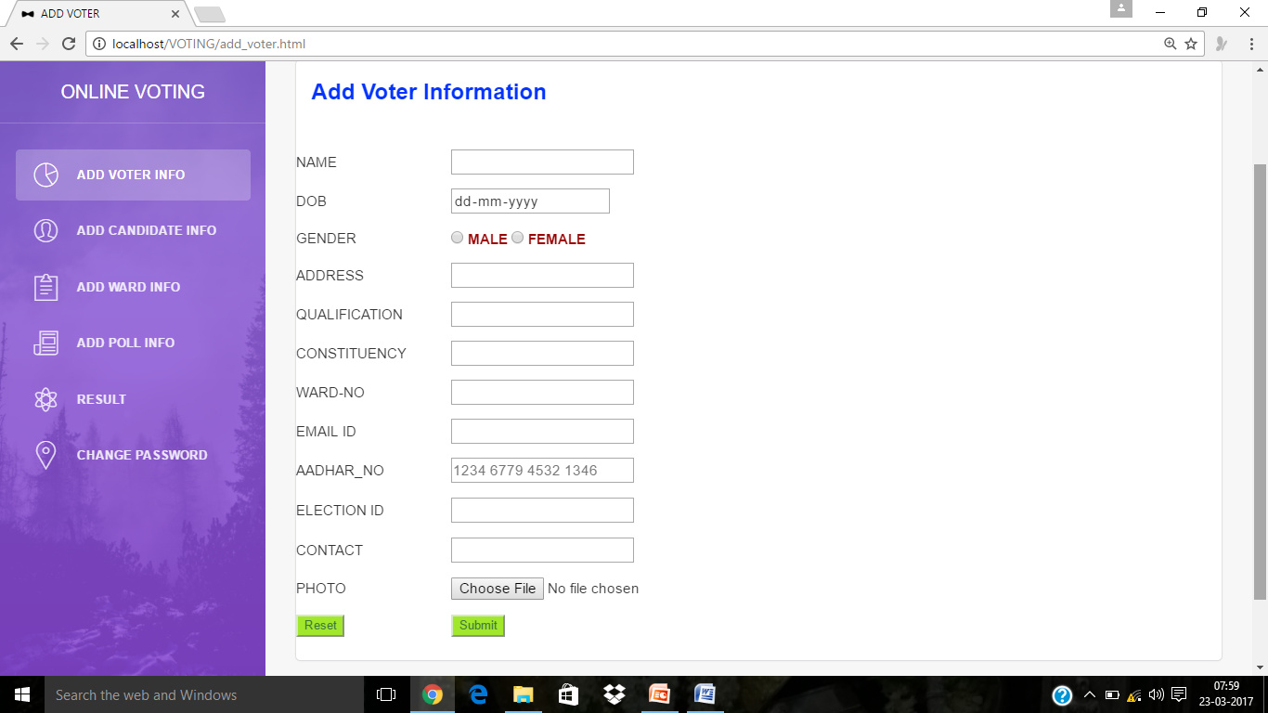
Add voting information page
Add voting information page

Slide 18
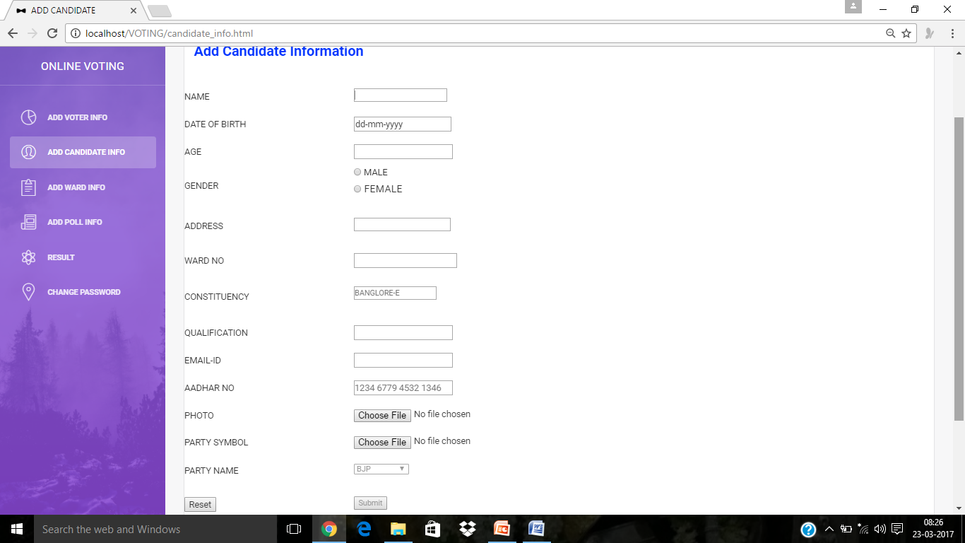
Add Candidate Info

Slide 19
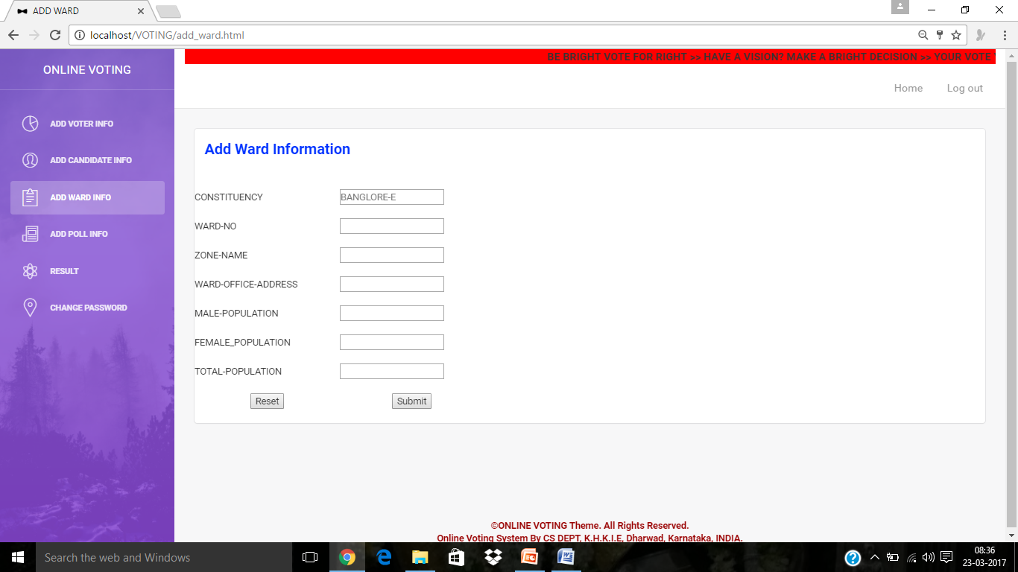
Add ward-details

Slide 20
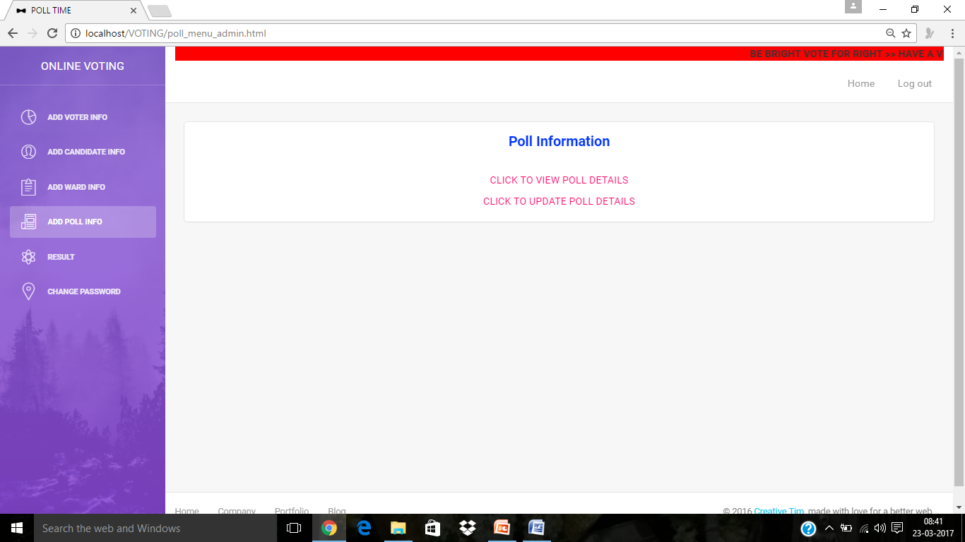
Poll details

Slide 21
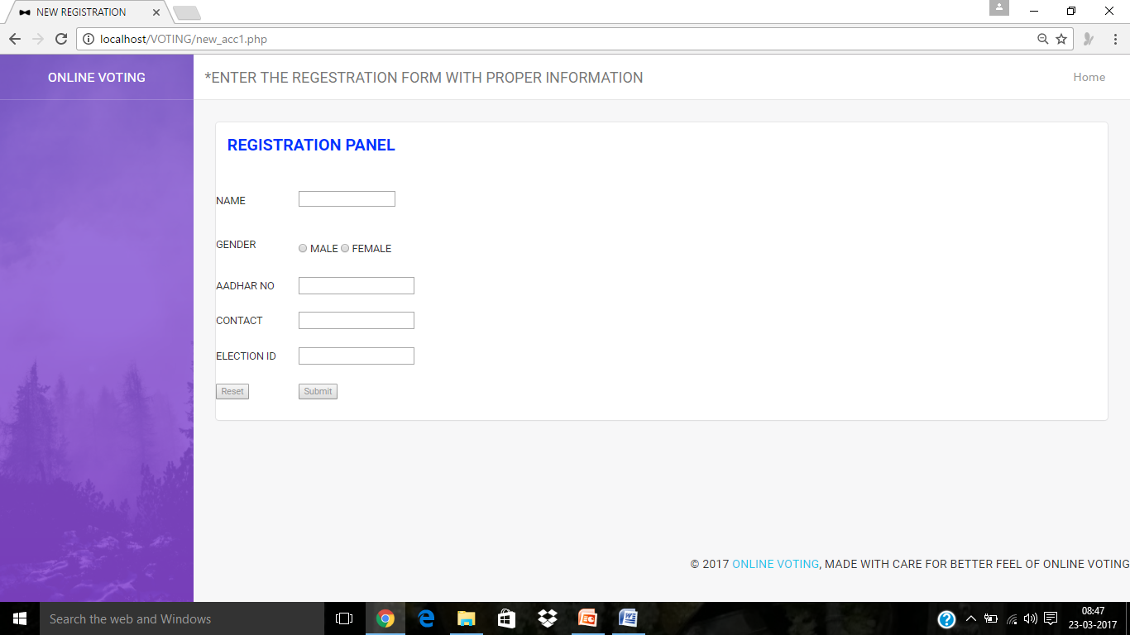
Register of the voter

Slide 22
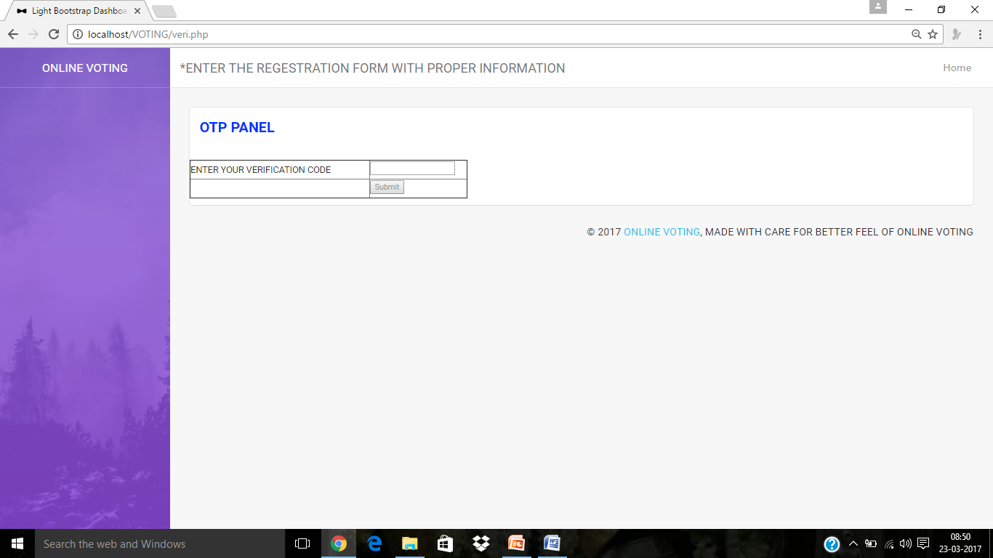
Entering the OTP

Slide 23
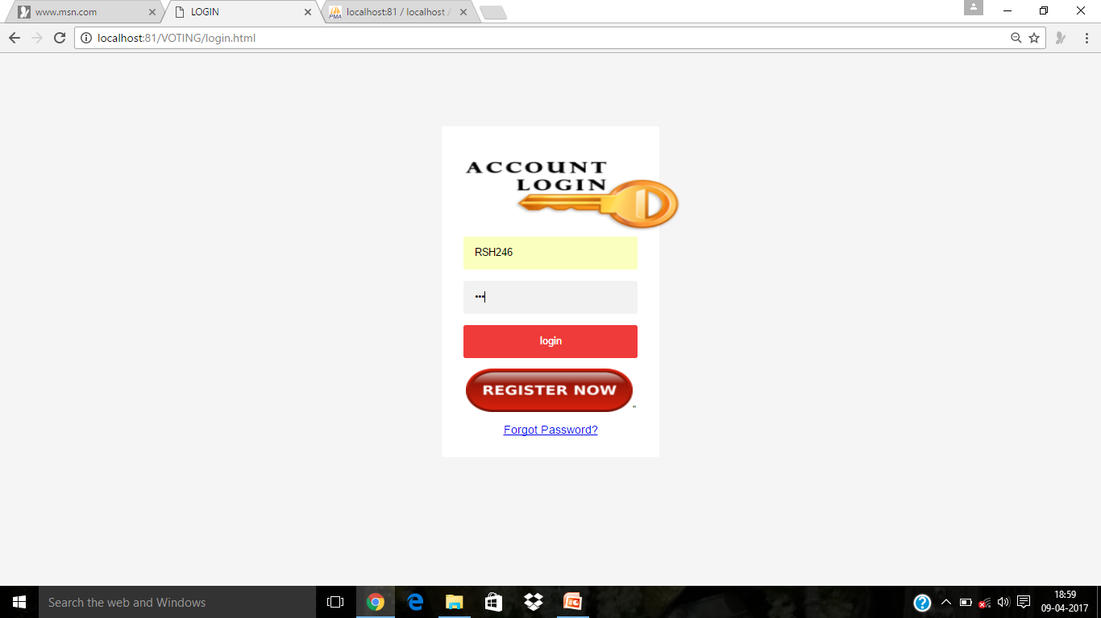
Login page of voter

Slide 24
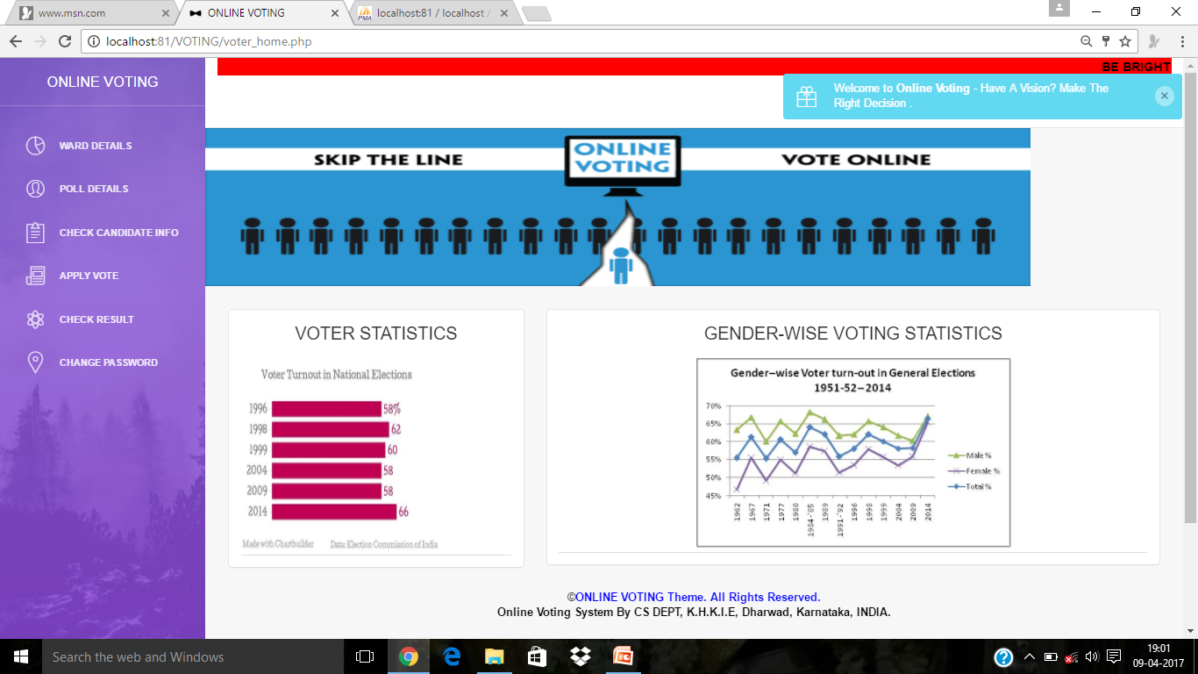
Voter home page

Slide 25
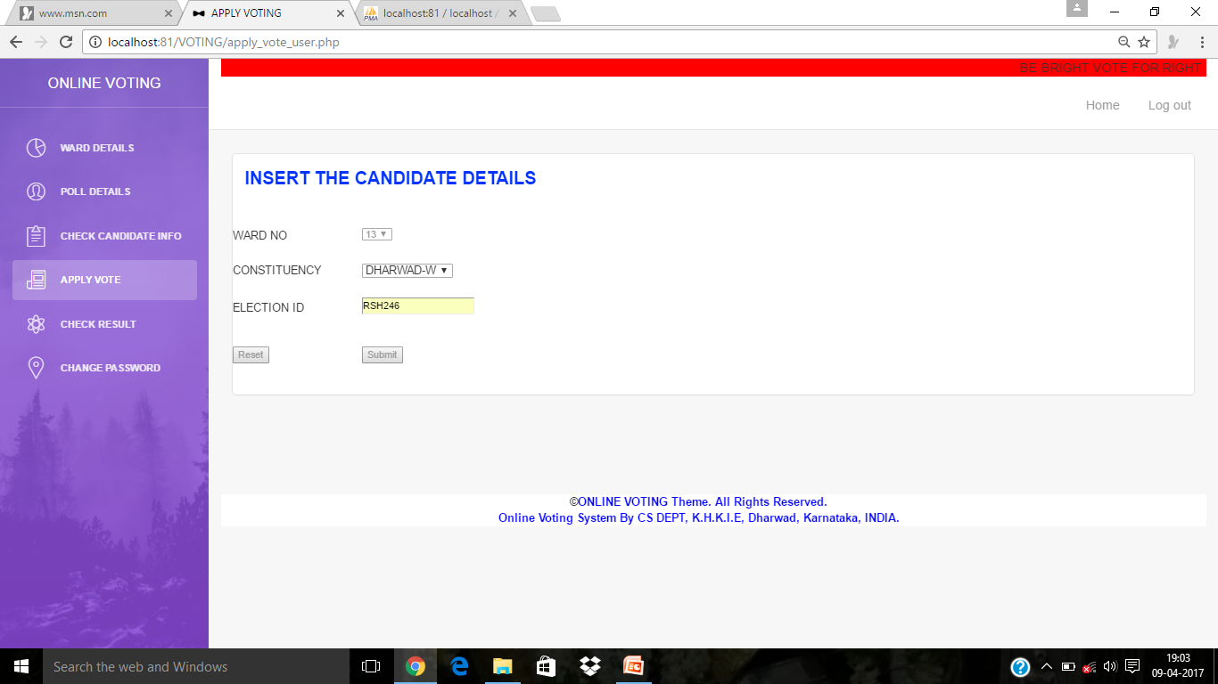
Apply vote

Slide 26
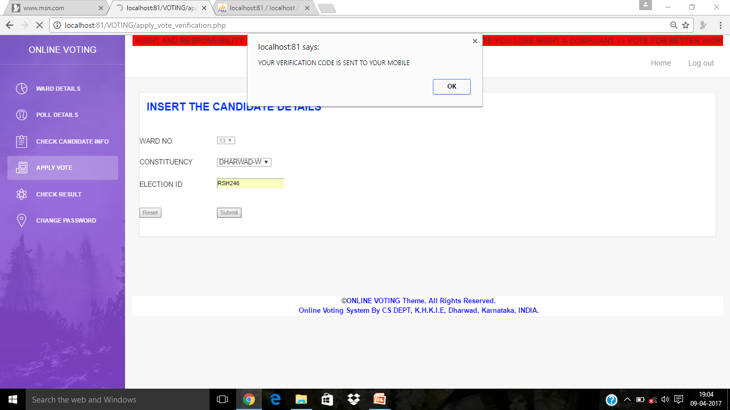
Voting process

Slide 27
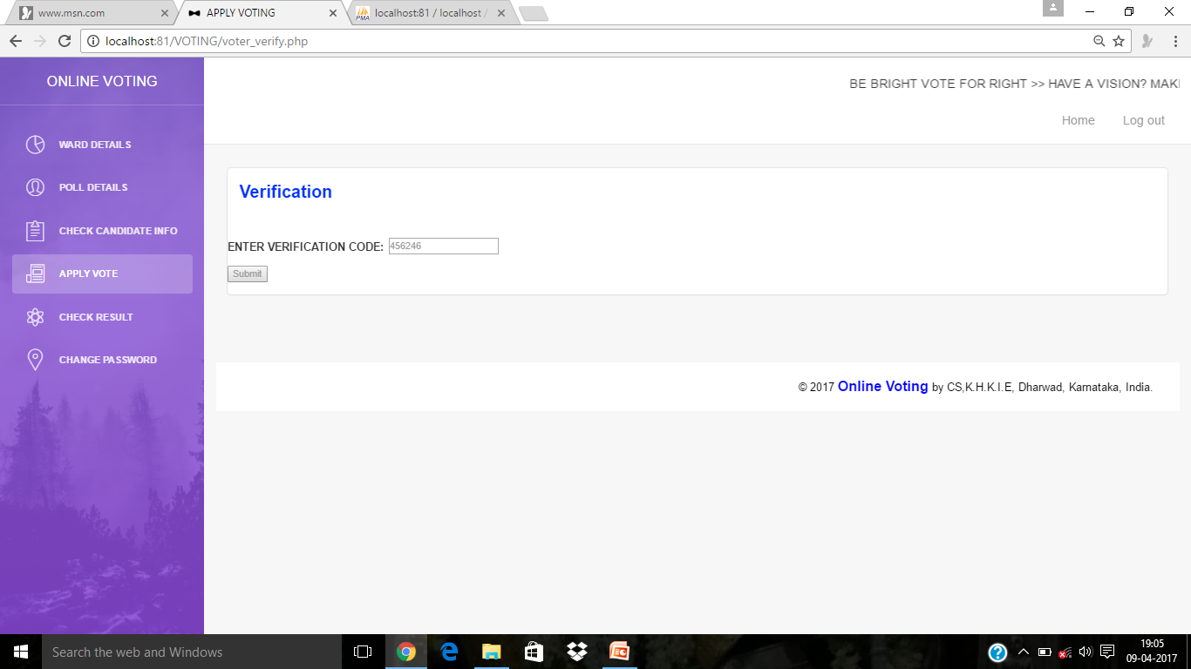
ENTERING THE OPT

Slide 28
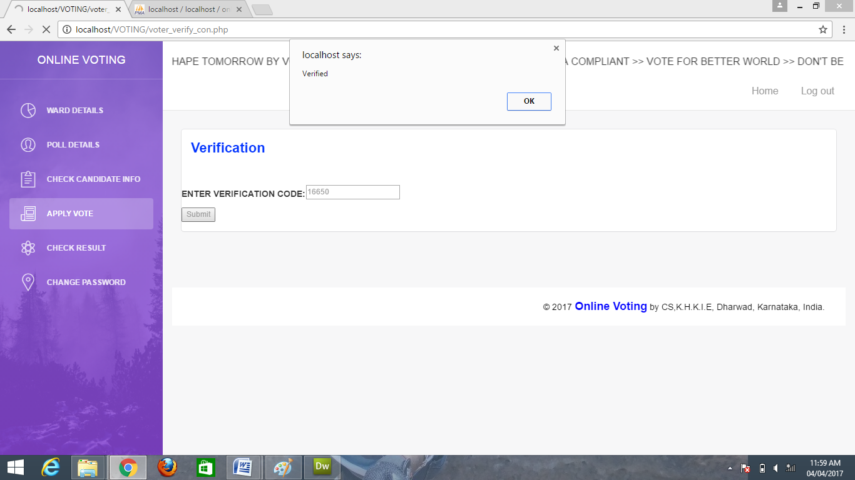
VERIFIED OTP

Slide 29
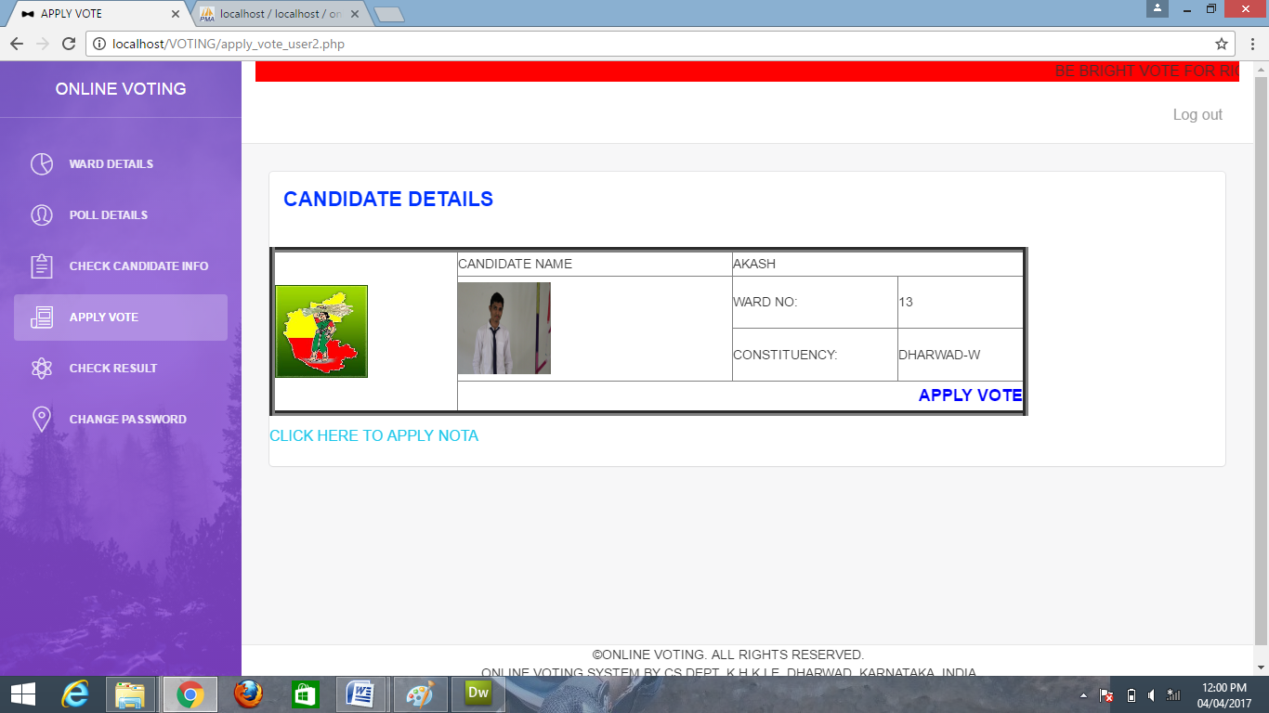
Apply vote

Slide 30
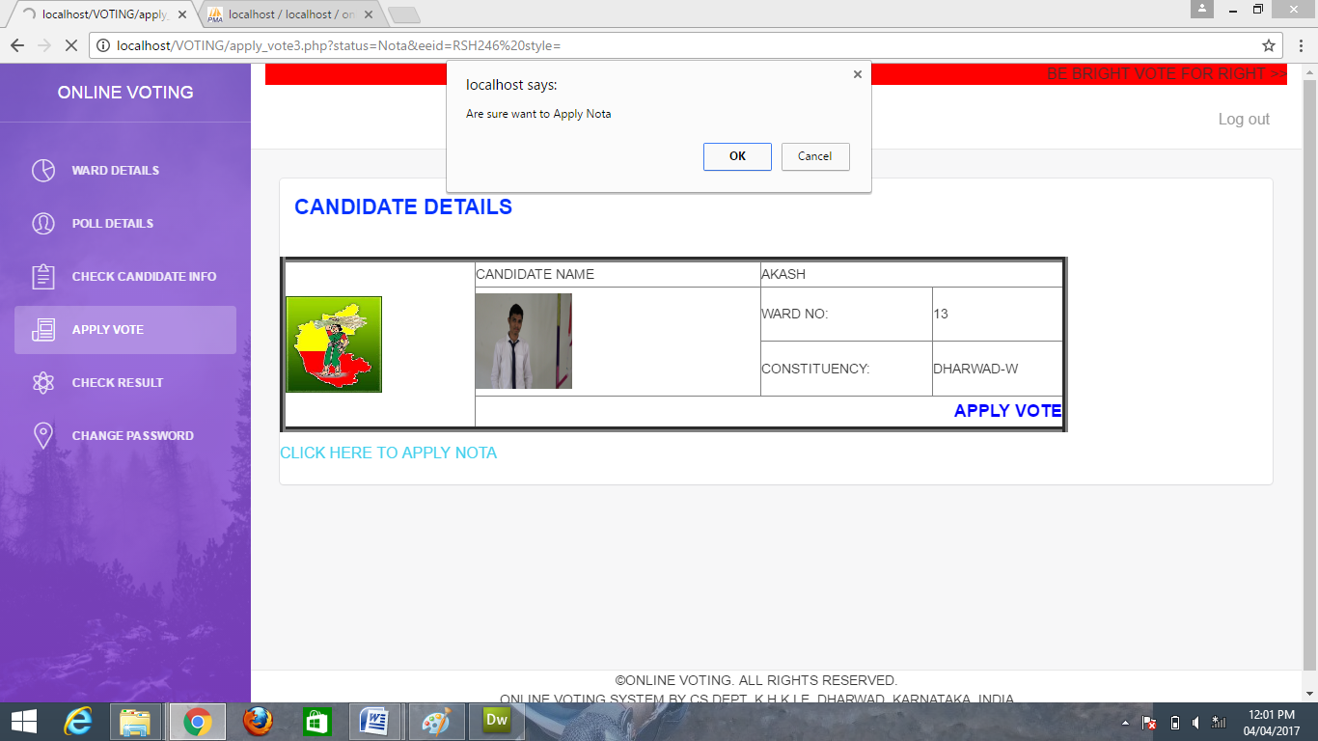
VOTED SUCCESSFULLY

Slide 31
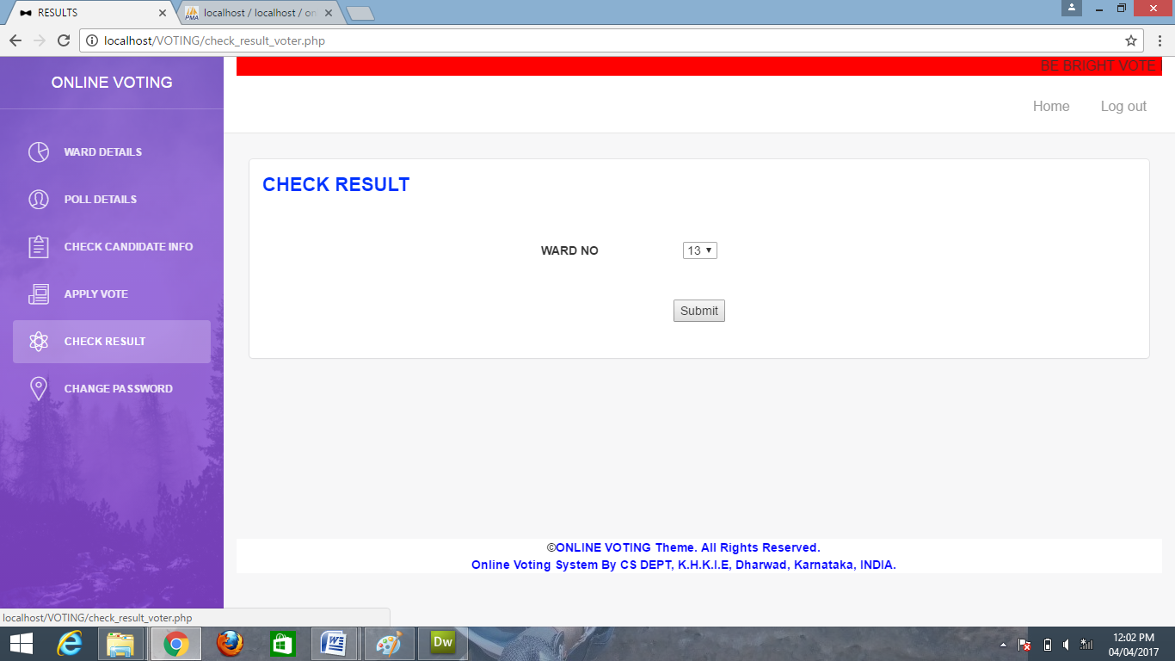
Check result

Slide 32
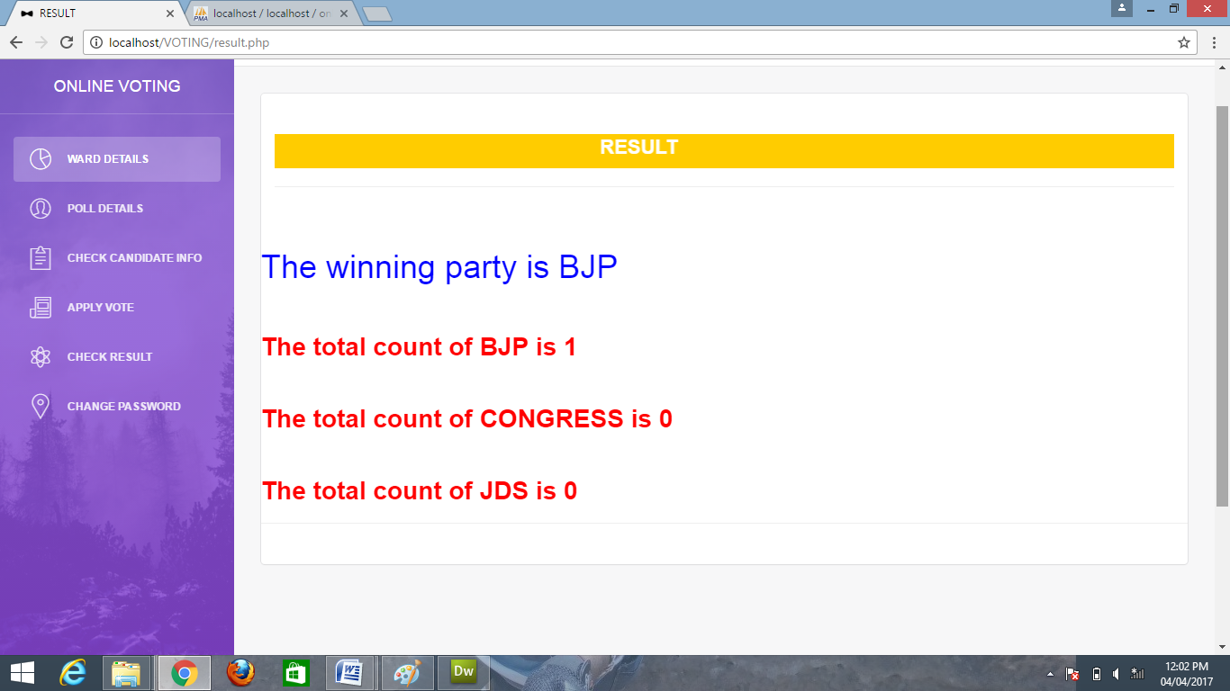
RESULT

Slide 33
THANK YOU SUBMITTED BY NEHA NADAF

